Slide 1


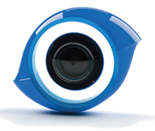



OpenCV 3.0
Overview
Gary Bradski
Chief Scientist, Perception and AI at Magic Leap CEO, OpenCV.org
Vadim Pisarevsky
Principal Engineer, Itseez
Grace Vesom
Senior Engineer in 3D at Magic Leap
Vincent Rabaud
Perception Team Manager at Aldebaran Robotics

Slide 2





OpenCV at glance
BSD license, 10M downloads, 500K+ lines of code
Huge community involvement, automated patch testing and integration process
Runs everywhere
Bindings: Python, Java
Samples, Apps, Solutions
OpenCV
Contrib
face, text, rgbd, …
core, imgproc, objdetect …
OpenCV
OpenCV HAL
SSE, NEON, IPP, OpenCL, CUDA, OpenCV4Tegra, …
Find more at http://opencv.org (user)
Or http://code.opencv.org (developer)

Slide 3
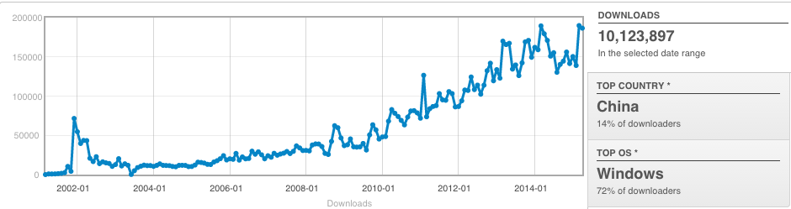
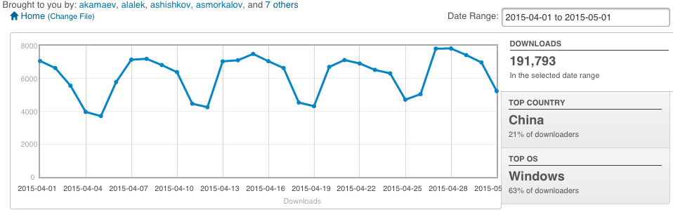
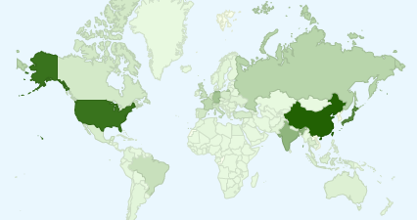
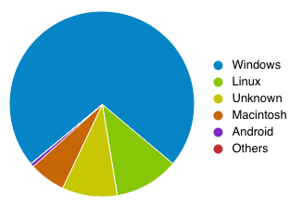
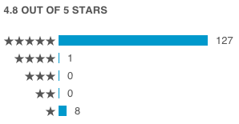
Recent Stats
> 10M downloads
NOTE:
This is only for source forge. Many more downloads come from Git and many more come on Unix distros.
~200K downloads/month
Rated highly
World wide

Slide 4
OpenCV History
Magic Leap
Renewed
Intel Support
OpenCV
Foundation
Nvidia Support
Intel Support
Willow Support
Release 2.0. C++
Release 2.1. Full Python support
Alpha Release at CVPR 2000. Windows only.
Release 2.2. Android Support
Beta 1. Linux support
Release 2.3. GPU Support. Modules
Release 2.4 LTS
OpenCV Started
Release 1.0
Release 1.1
Release 3.0 Refactored
1999
2000
2001
2002
2003
2004
2005
2006
2007
2008
2009
2010
2011
2012
2013
2014
2015
Development team has moved to Itseez
Google Summer of Code

Slide 5
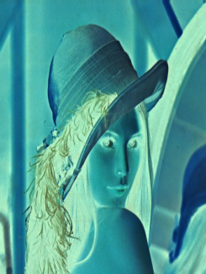

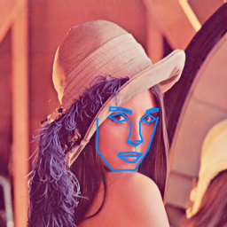
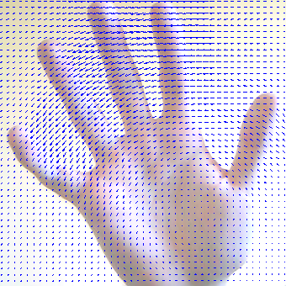

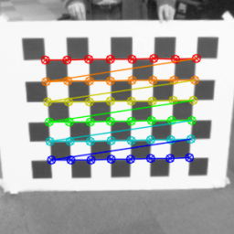
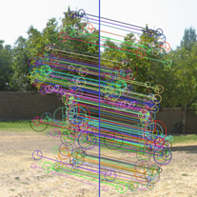

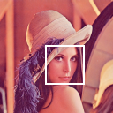
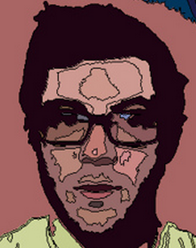
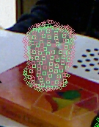
OpenCV Algorithm Modules Overview
HighGUI:
I/O, Interface
Image Processing
Transforms
Fitting
Optical Flow
Tracking
Segmentation
Calibration
Features
VSLAM
Depth, Pose
Normals, Planes, 3D Features
Object recognition Machine learning
Computational Photography
CORE:
Data structures, Matrix math, Exceptions etc

Slide 6
OpenCV 3.0 at glance
Goal of 3.0: make a better OpenCV 2.0, cleanup API, get better performance (with T-API, IPP, NEON), shift to modular structure and enable user contributions
3.0 alpha
3.0 beta
3.0rc
3.0
3.1
Aug’14
Nov’14
Apr’15
Jun’15
Q4’15
Mostly compatible with OpenCV 2.x; OpenCV 1.x C API is deprecated and partially removed
Highlights:
even more modular and extendible
very stable API tailored for a long-term support
decent out-of-box performance: IPP, OpenCL(T-API) and NEON
lot’s of new functionality!

Slide 7
opencv => opencv + opencv_contrib
OpenCV 3.x contributions
OpenCV 2.x
OpenCV 3.x
The “main” opencv repository includes mature algorithms and is fully supported
A separate contribution repository is for new CV algorithms that people want to share: http://github.com/itseez/opencv_contrib
Patches to the contrib repository are tested as well by our buildbot to ensure integrity!

Slide 8
Using opencv_contrib
The modules in contrib have the same structure as the standard ones:
opencv/
modules/
core/
include/, doc/, src/, test/, …
CMakeLists.txt
imgproc
…
opencv_contrib/modules
text/
include/, doc/, src/, test/, …
CMakeLists.txt
…
Path to the contrib modules can be passed to cmake to build them together with OpenCV:
$ cmake –D OPENCV_EXTRA_MODULES_PATH=~/opencv_contrib/modules …
Multiple ;-separated directories can be specified

Slide 9
New-style C++ API
Unified API of all the high-level vision algorithms (face detection, optical flow estimation, stereo matching etc.):
Interfaces are pure abstract classes
Implementations are completely hidden
Properties are set/retrieved using special dedicated methods (intellisense-friendly)
OpenCV 2.4.x
OpenCV 3.0
// stereo
StereoSGBM stereo;
stereo.P1 = 5;
stereo.P2 = 50;
Mat left, right, disp;
stereo(left, right, disp);
// features 2D
ORB orb;
orb.set(“nfeatures”, 1000);
Mat image, descriptors;
vector<KeyPoint> keypoints;
orb(image, keypoints, descriptors);
// machine learning
CvSVM svm; CvSVMParams params;
params.kernel_type=CvSVM::LINEAR;
param.svm_type=CvSVM::C_SVC;
param.C=1;
svm.train(data, resp, 0, 0, params);
// stereo
Ptr<StereoSGBM> stereo = StereoSGBM::create();
stereo->setP1(5); stereo->setP2(50);
Mat left, right, disp;
stereo->compute(left, right, disp);
// features 2D
Ptr<ORB> orb = ORB::create();
orb->setMaxFeatures(1000);
Mat image, descriptors;
vector<KeyPoint> keypoints;
orb->detectAndCompute(image, noArray(), keypoints, descriptors);
// machine learning
Ptr<ml::SVM> svm=ml::SVM::create();
svm->setType(SVM::C_SVC);
svm->setKernel(SVM::LINEAR);
svm->setC(1);
svm->train(data, ROW_SAMPLE, resp);

Slide 10
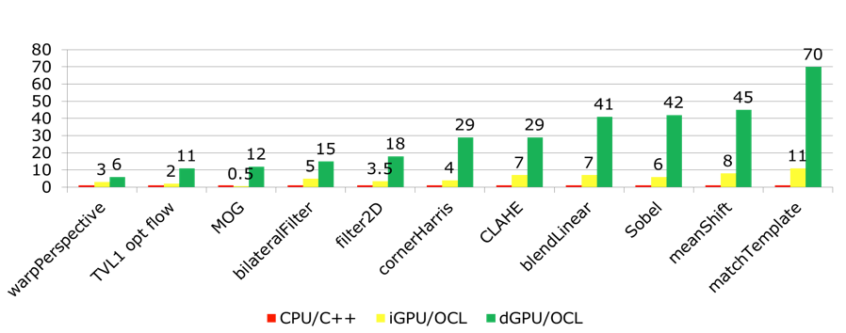
Transparent API (T-API) for GPU acceleration
single API entry for each function/algorithm – no specialized cv::Canny, ocl::Canny, gpu::Canny etc.
uses dynamically loaded OpenCL runtime if available; otherwise falls back to CPU code. Dispatching is at runtime, no recompilation needed!
~100 functions are optimized

Slide 11
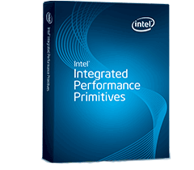

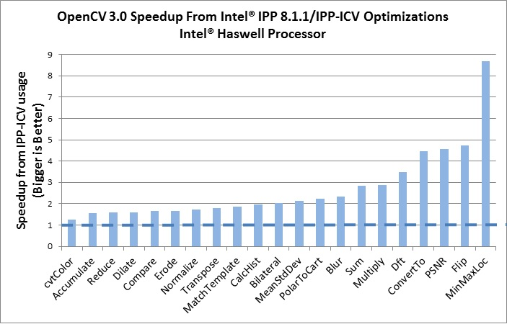
IPP + OpenCV = v. fast OpenCV
Intel gave us and our users free (as in “beer”) and royalty-free subset of IPP 8.x (IPPICV), several hundreds functions!
IPPICV is linked into OpenCV at compile stage and replaces the corresponding low-level C code (WITH_IPP=ON/OFF, ON by default)
Our buildbot ensures that all the tests pass

Slide 12

New Functionality and other improvements
Results from 20+ successful projects from GSoC 2013, 2014:
Computational photography, Text detection, Object Tracking, Matlab bindings etc.
1500+ Pull Requests @ github (~800 PR’s between alpha & the gold)
18 new OpenCV modules! (mostly in opencv_contrib)

Slide 13
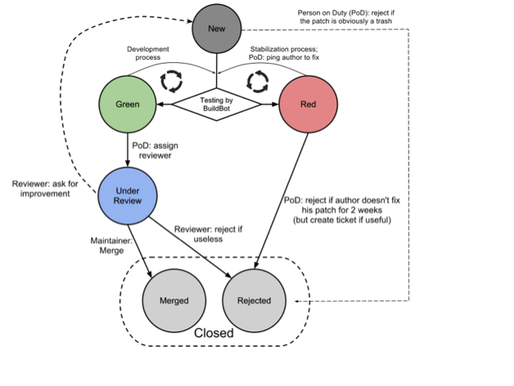
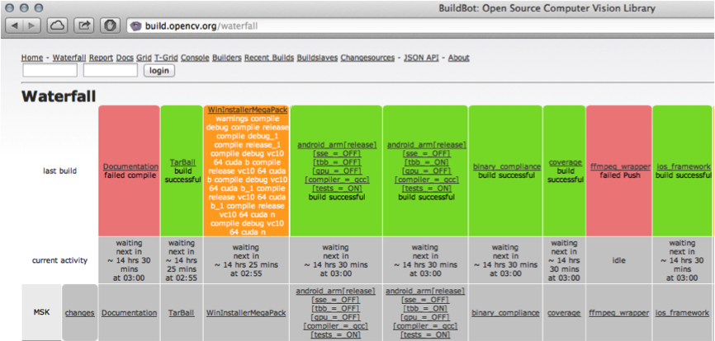
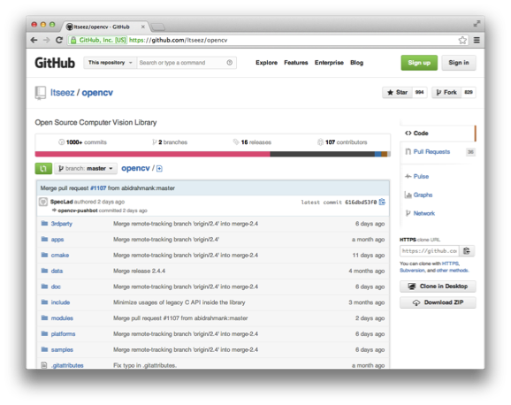
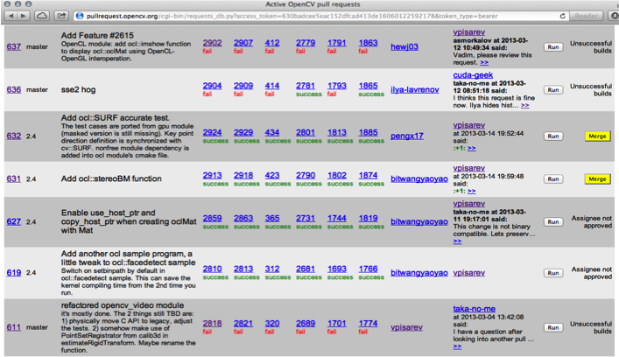
OpenCV QA
Contribution/patch workflow:
see OpenCV wiki
http://build.opencv.org: buildbot with 50+ builders
http://github.com/itseez/opencv
http://pullrequest.opencv.org: tests each pullrequest

Slide 14
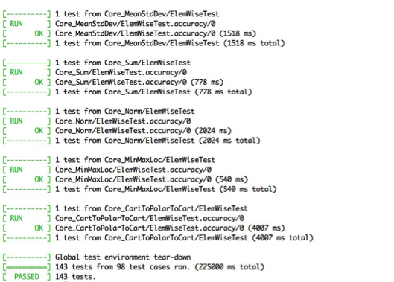
OpenCV test suite
GoogleTest-based + set of Python scripts
Thousands of unit tests
Accuracy tests
Performance tests
python ../modules/ts/misc/summary.py core*.xml -f "add:.*C4" -u s
Geometric mean
Name of Test core core core
posix posix posix
x64 x64 x64
6693M 6695 6695
2011-09-08--13-13-41 2011-09-08--13-30-06 2011-09-08--13-30-06
vs
core
posix
x64
6693M
2011-09-08--13-13-41
core_arithm__add::Size_MatType::(127x61, 8UC4) 0.000 s 0.000 s 1.00
core_arithm__add::Size_MatType::(1280x720, 8UC4) 0.004 s 0.004 s 0.99
core_arithm__add::Size_MatType::(1920x1080, 8UC4) 0.009 s 0.009 s 1.02
core_arithm__add::Size_MatType::(640x480, 8UC4) 0.001 s 0.001 s 1.00

Slide 15
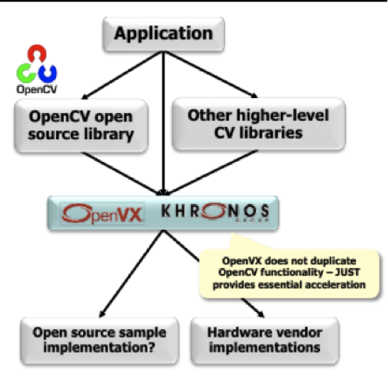

OpenVX (Khronos HAL)
OpenCV was one of the key contributors to the new Khronos accelerated vision API: OpenVX
(Hardware Acceleration Library)

Slide 16

New from Google Summer of Code 2015
Deep network optimized execution and interoperability to existing libraries
Stereo matching improvements
Projection mapping
Improved Camera Calibration
Better AR fiducial support
Improvements to text detection and tracking
Neon optimization

Slide 17
Other Initiatives: CVPR State of the Art Vision Challenge
State of the Art Vision Challenge at CVPR 2015
Our aim is to make available state of the art vision in OpenCV. We thus ran a vision challenge to meet or exceed the state of the art in various areas. We will present the results.
The contest details are available at:
http://code.opencv.org/projects/opencv/wiki/VisionChallenge
Prizes:
Win: $1000; Submit code: $3000
Win: $1000; Submit code: $3000
Win: $1000; Submit code: $3000
Win: $1000; Submit code: $3000
Win: $1000; Submit code: $3000

Slide 18
Other Initiatives: People’s Choice: Best Paper
People’s Choice: Best paper
We will tally the people’s vote for best paper/paper you’d most like to see implemented. We’ll present the histogram of results which is an indication of the algorithms people are interested in overall and then list the 5 top winners.
Prizes will be awarded in two stages:
A modest award for winning and
a larger award for presenting the code w/in 5 months as a pull request to
OpenCV as Detailed here:
http://code.opencv.org/projects/opencv/wiki/How_to_contribute
Prizes:
Win: $500; Submit code: $6000
Win: $300; Submit code: $4000
Win: $100; Submit code: $3000
Win: $50; Submit code: $3000
Win: $50; Submit code: $3000

Slide 19

Functional Language Exploration
Proliferation of new hardware makes it hard to support code.
Let the compiler port to different hardware using a functional language “numl”
Can compile numl to optimized, vectorized C.
numl is an array/image comprehending functional language - to come later this year

Slide 20
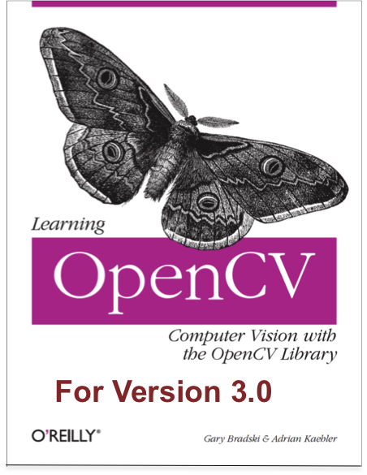
Learning OpenCV 3.0
Out in late summer!
Also, check the other books and online tutorials at http://opencv.org

Slide 21
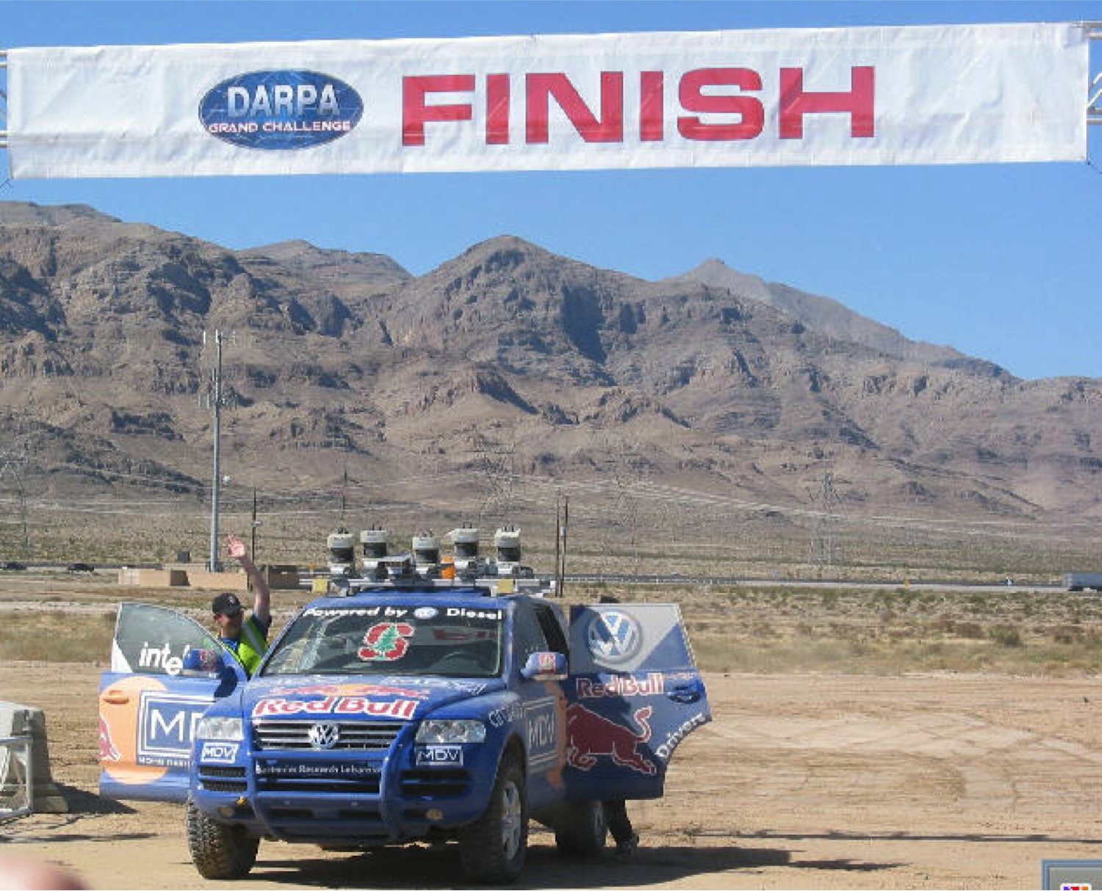

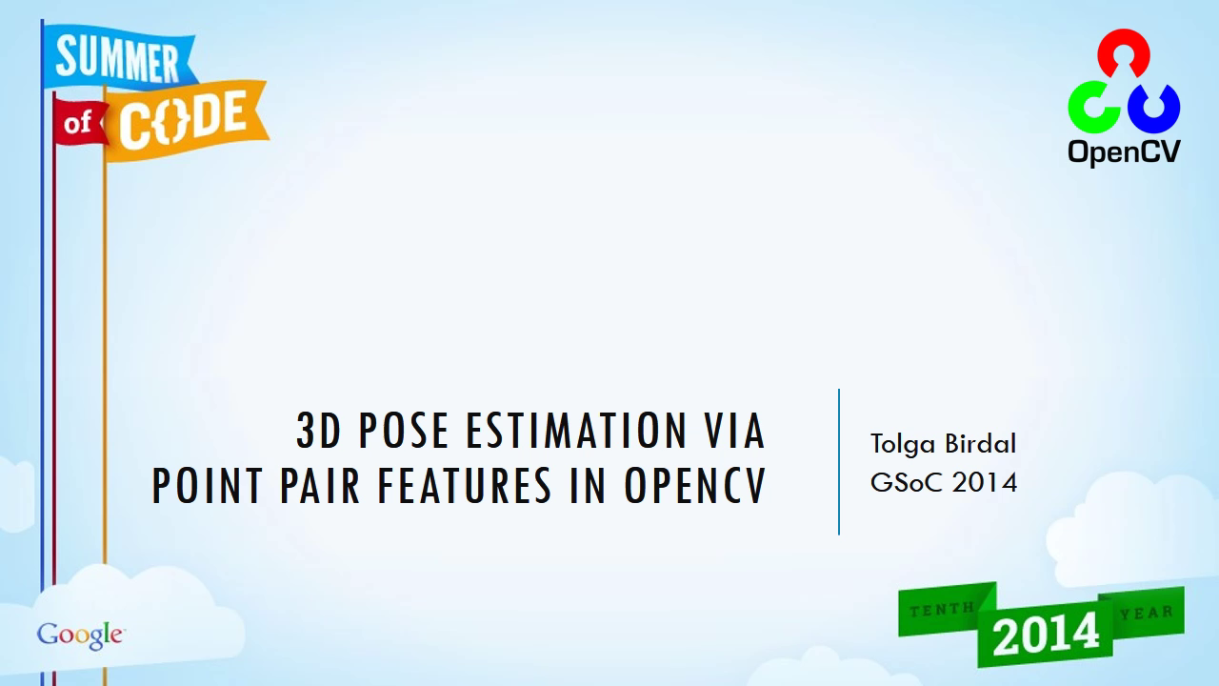
Questions?
http://youtu.be/LE7aiONMjK4
Photo: Gary Bradski
Notes:
‹#›

